Slide 1


Team 20: 3-Phase Matrix Converter
Bi-Weekly Update 5 Chase Barnes, Daniel Loeza, Shanelle Algama Sponsor: Dr. John Lusher TA: Rhett Guthrie
Notes:
Michelle

Slide 2
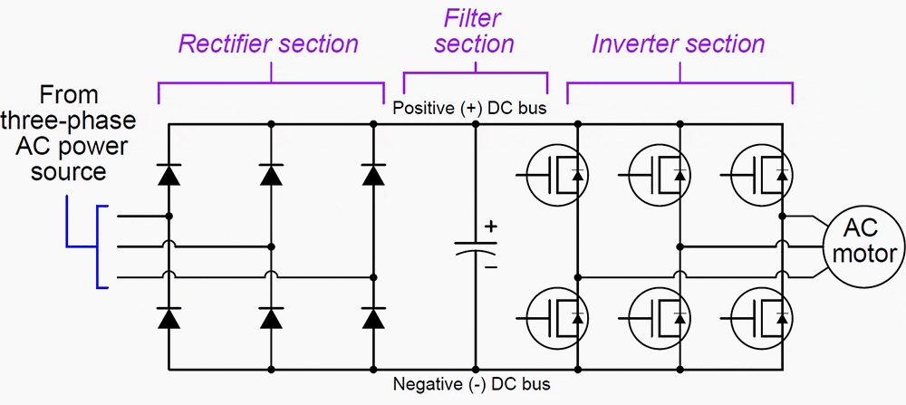
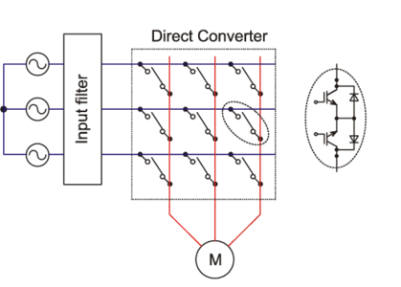
Project Summary
Traditional Variable Frequency Drives utilizes AC-DC-AC conversion:
Decreased efficiency across power output, and increased harmonic distortion.
3 Phase Matrix Converter utilizes AC-AC conversion:
Reduced efficiency loss across components.
Notes:
Barnes

Slide 3
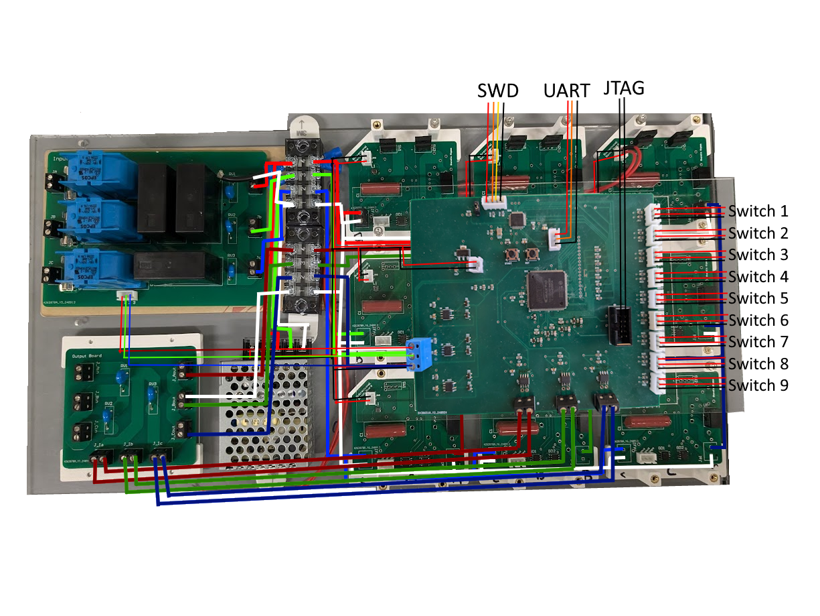
Integrated System Diagram
Notes:
TODO HAVE EVERYONE ELSE LOOK AT

Slide 4
Project Timeline
September 19 - Pulse Generator PCB will be assembled.
September 30 - Full Matrix of Bidirectional Switches will be assembled
October 7 - Pulse Generator Subsystem will be validated and functional.
October 10 - Firmware will be integrated with the Pulse Generator
October 14 - Matrix Converter Subsystem will be validated and functional
October 14 - Full System Integration will begin.
November 11 - System will be validated and functional.
November 21 - Final Demo
Notes:
Eric

Slide 5
Chase Barnes
Accomplishments since last update 18 hrs of effort | Ongoing progress/problems and plans until the next presentation
Fixed Clock hardware issue in software for FPGA Diagnosed and additional validation on zero crossing sensors with further issues found Soldered additional wiring on pulse generator Created 3D Printed mount for input filter Found additional issues with FPGA and JTAG Hardware Validated Microcontroller Timing | Work with Daniel on Changing JTAG, LED, Zero Crossing, FPGA Power supply issues in hardware FPGA Timing Validation after Previous issues resolved Finish 3d Printed mount for Pulse Generator

Slide 6
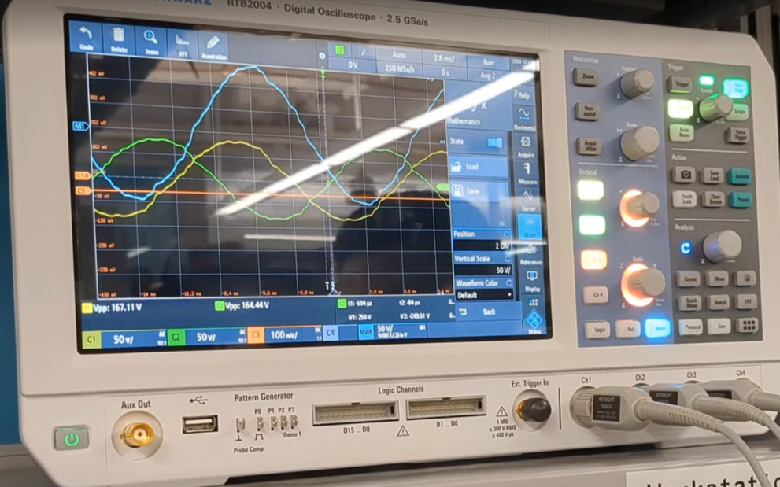
Chase Barnes
Zero Crossing Validation Issues

Slide 7
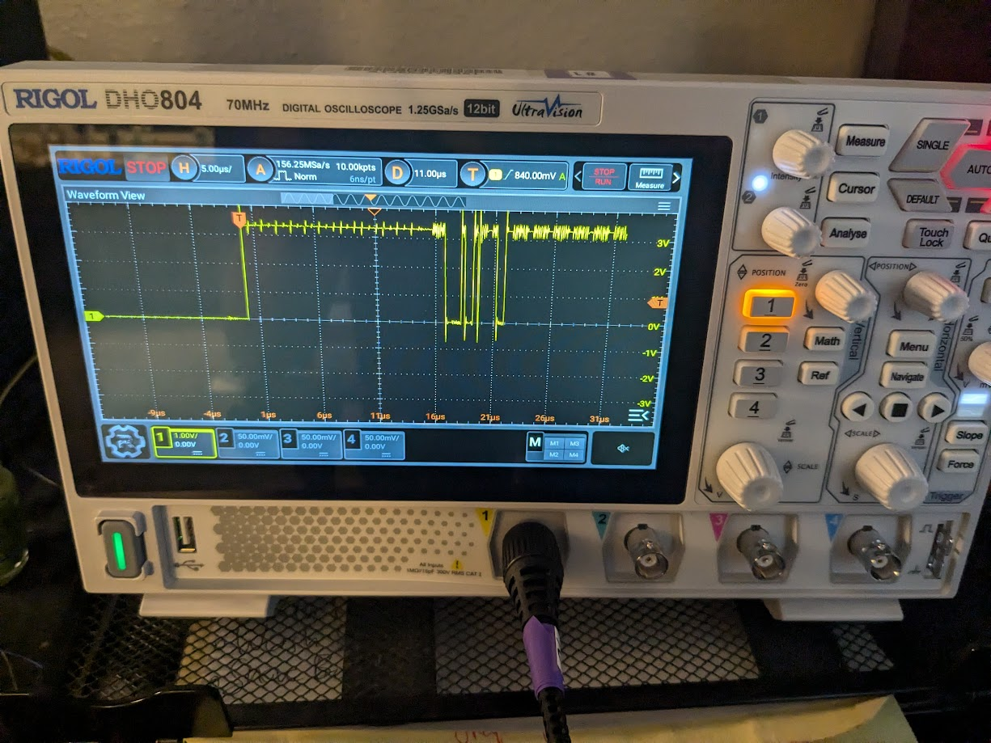
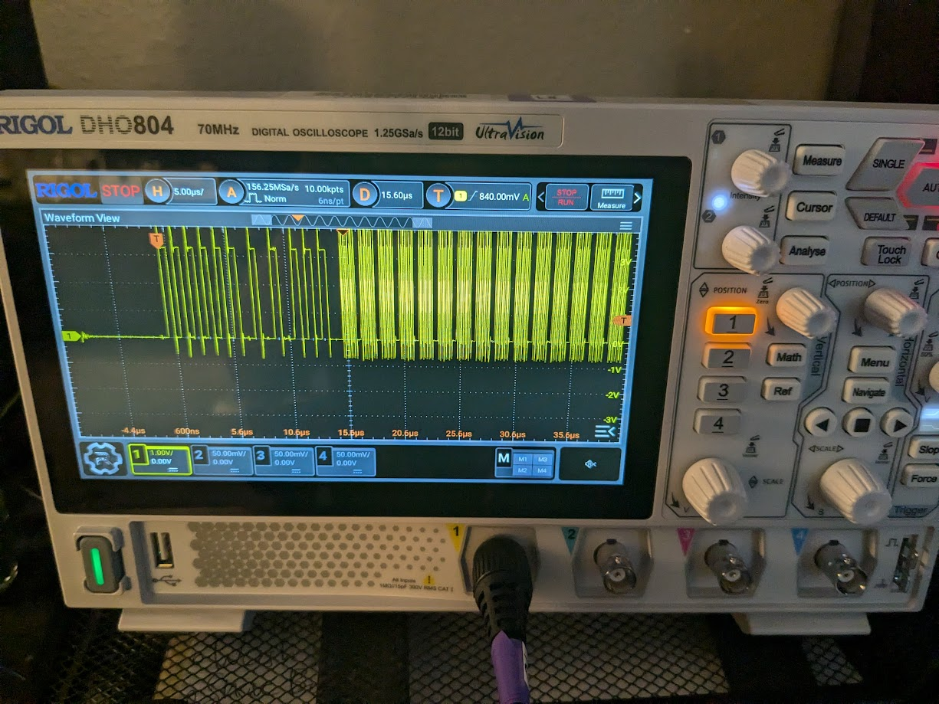
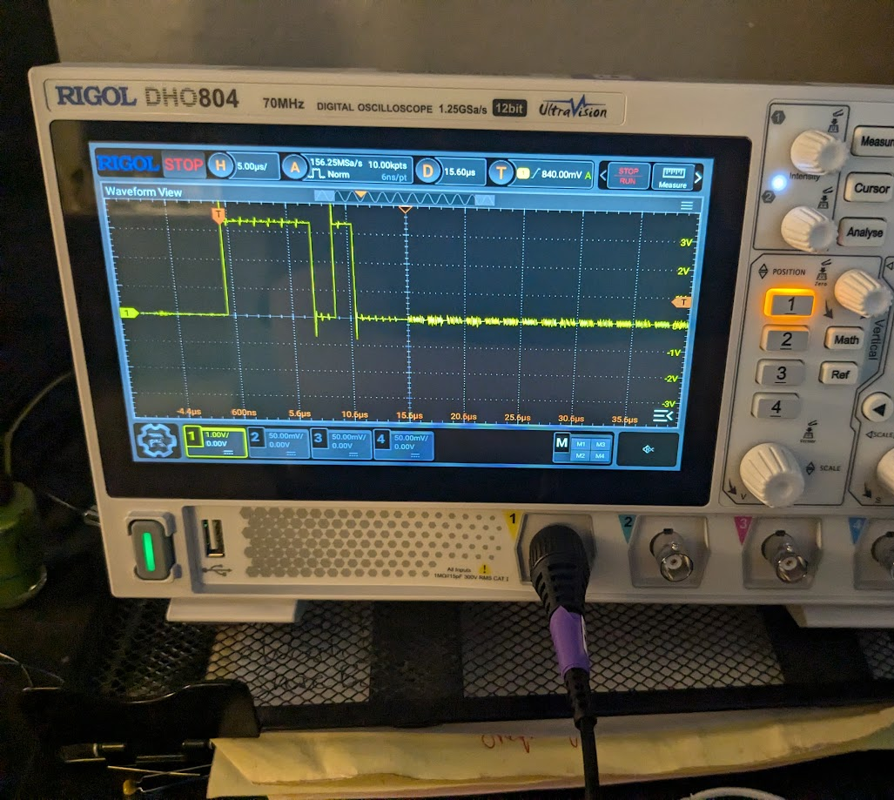
Chase Barnes
JTAG Connection Issues

Slide 8
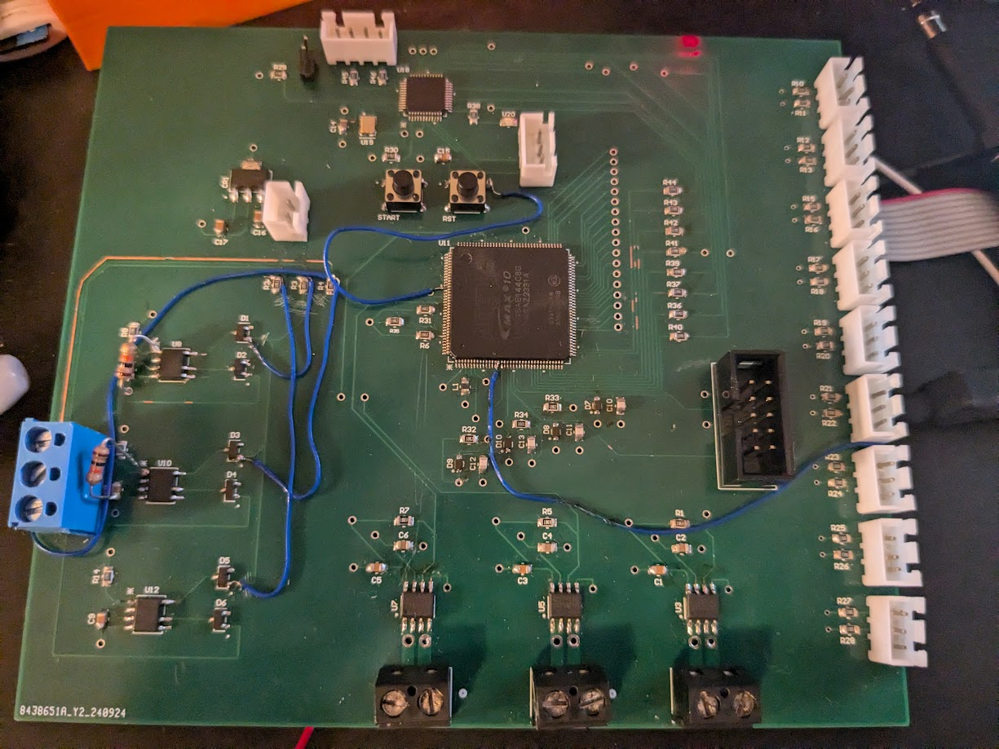
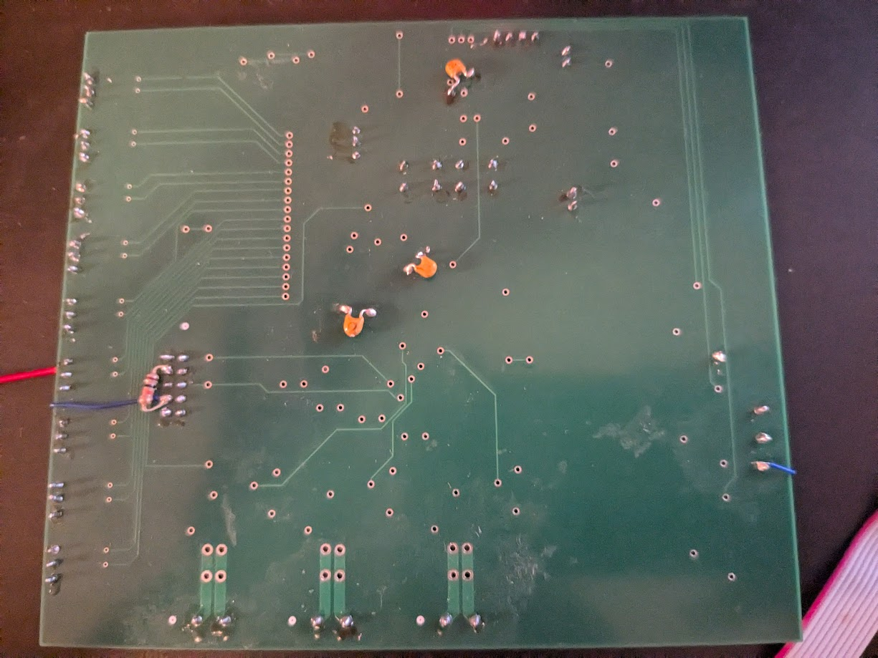
Chase Barnes
Additional Wiring Soldered to try and get FPGA to Flash

Slide 9
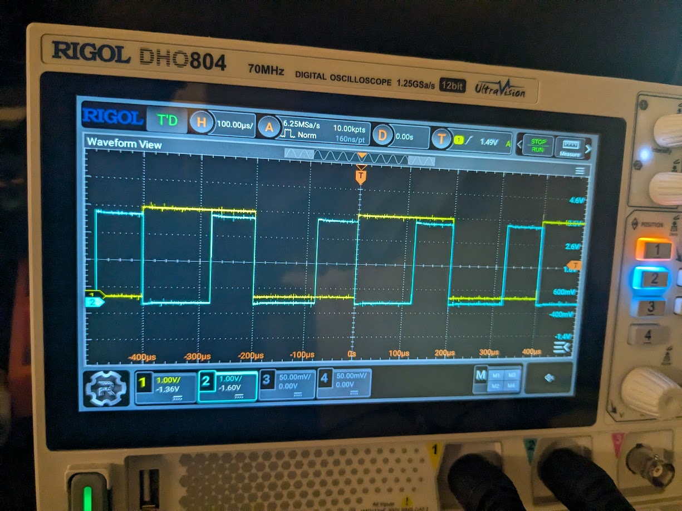
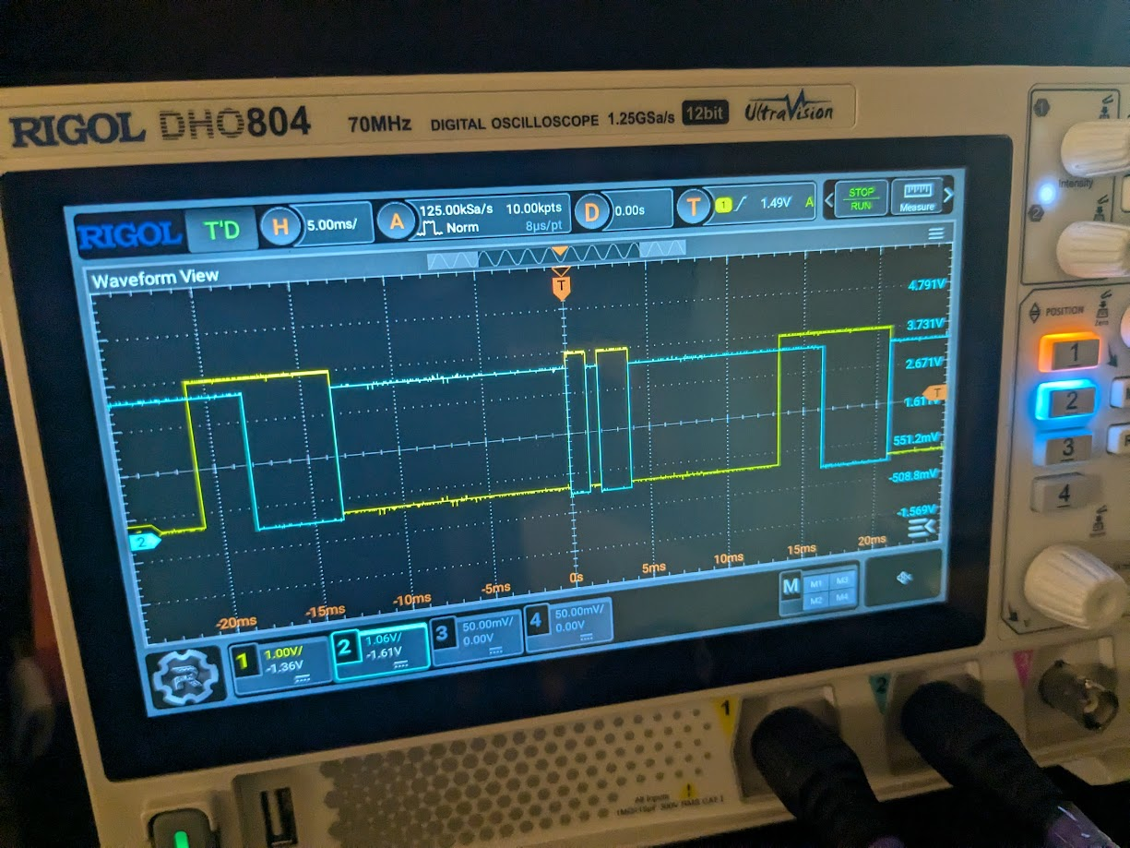
Chase Barnes
Debug Timing setting output from 0 to 2 for C Phase Bus
Timing for 60Hz to 60Hz for C Phase Bus
Microcontroller timing validation

Slide 10
Shanelle Algama
Accomplishments since last update 7 hours of effort | Ongoing progress/problems and plans until the next presentation
-Tested Bidirectional Switch with a similar inductor to the ones I purchased (while waiting for the new ones to arrive) but that did not fix the problem -Received the new inductors (after delays) and attempted validation testing with that -Finally diagnosed cause of problem on the Bidirectional Switch | -New parts ordered and will be assembled when received (higher power rating resistors and thermal pads) -Solder new components to the rest of the boards after completed validation

Slide 11
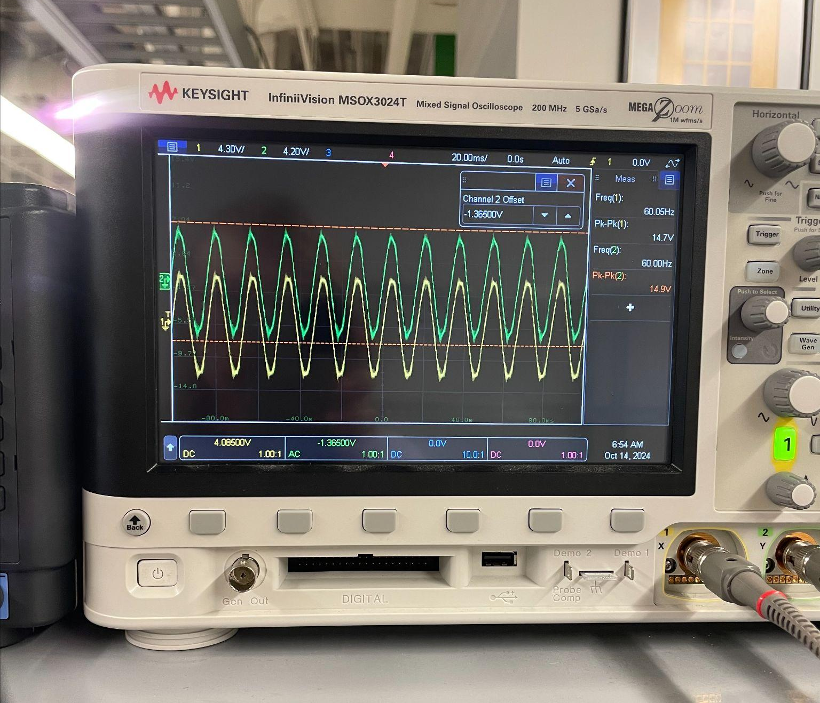
Shanelle Algama

Slide 12
Daniel Loeza
Accomplishments since last update 12 hrs of effort | Ongoing progress/problems and plans until the next presentation
Added resistors to the voltage sensors | Continue working with Chase on resolving JTAG, LED, Zero Crossing, FPGA Power issues Validation is still ongoing Crimp connections for the system

Slide 13
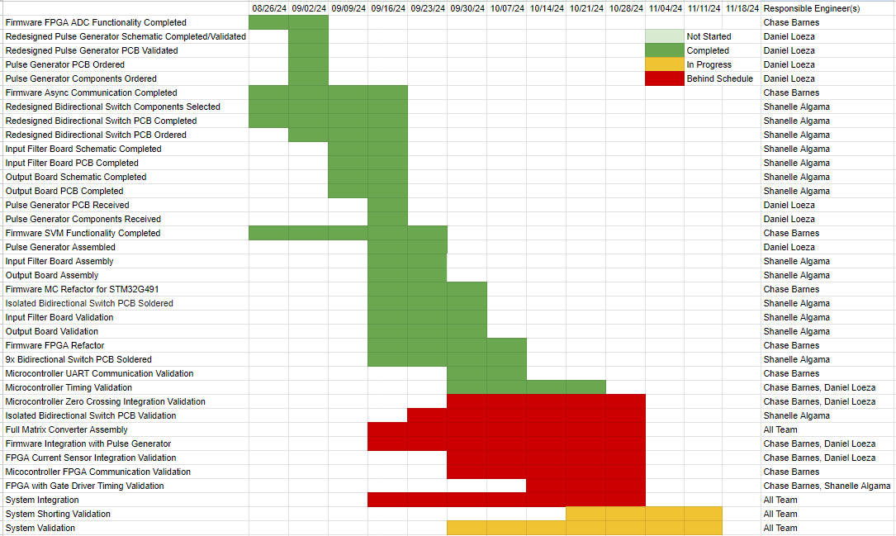
Execution Plan
Notes:
Michelle

Slide 14
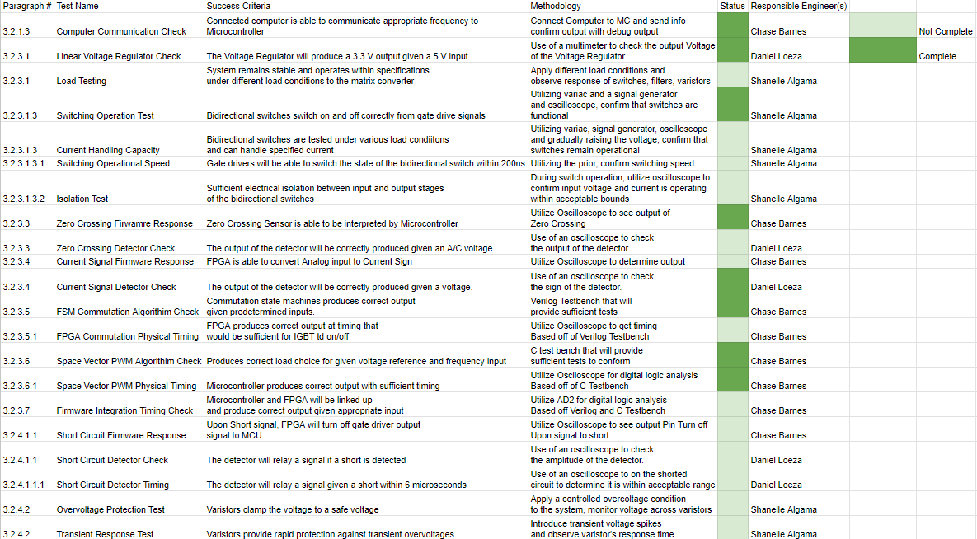
System Validation Plan
Notes:
Michelle

Slide 15
Thanks, and Gig ‘em!

